Slide 1
AGRICULTURAL LOAN MONITORING TOOL
INTERNAL GUIDE:
Dr.K. Venugopal Rao
Professor
PRESENTED BY:
S.Pujitha(14251A0548)
V.Harshitha(14251A0558)
P.Sanjitha (14251A0598)

Slide 2
INTRODUCTION
Agricultural lenders are facing many challenges when evaluating the credit worthiness of loan borrowers
Financial institutions has to monitor its loan system to mitigate risks
This tool provides the information needed to oversee loan portfolio at any time, identifying potential problems

Slide 3
MODULES
Monitor climatic conditions for agricultural land (Using Arduino)
Sending the sensor data to cloud(Thingspeak)
Analyze the sensor data ( Using Algorithms)
Suggest lenders to grant or waive the loans

Slide 4
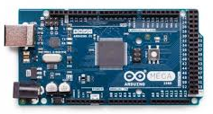
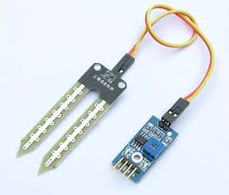
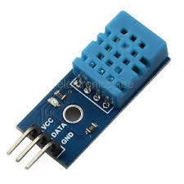
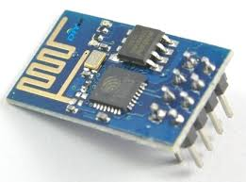
REQUIREMENTS
Hardware requirements:
Arduino board
ESP8266 Wifi module
DHT 11 sensor
Soil Moisture sensor
Software requirements:
Arduino development tool
Thingspeak
Bootstrap
Xampp

Slide 5
MECHANISM
Various sensor nodes are deployed at different locations in the farm
Real time Sensor data is collected and sent to thingspeak
Analyze the data and suggest loan lenders based on the algorithm

Slide 6
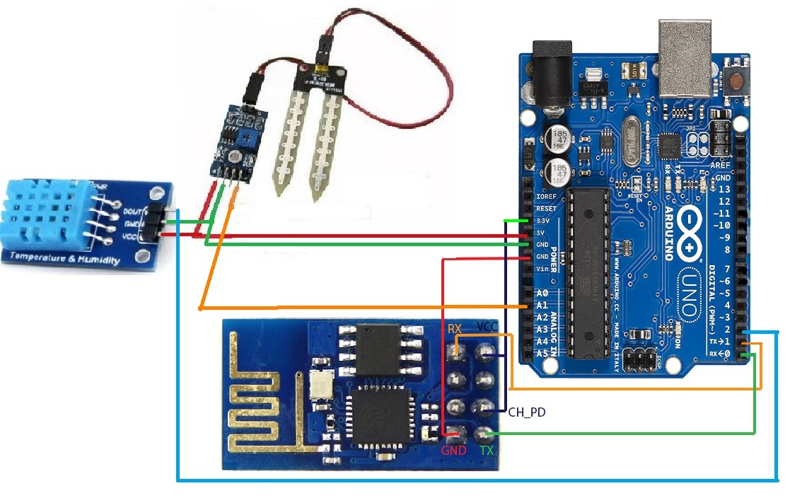
CIRCUIT DIAGRAM

Slide 7
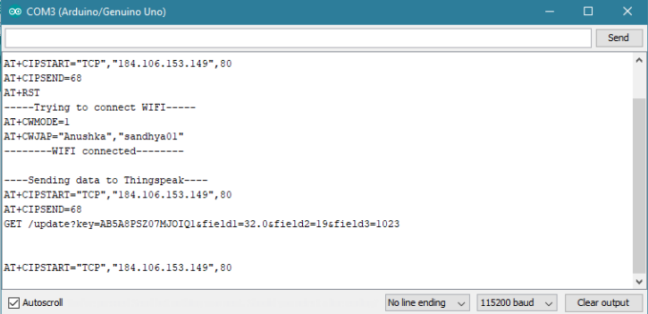
Arduino IDE Output – Sending data to thingspeak

Slide 8
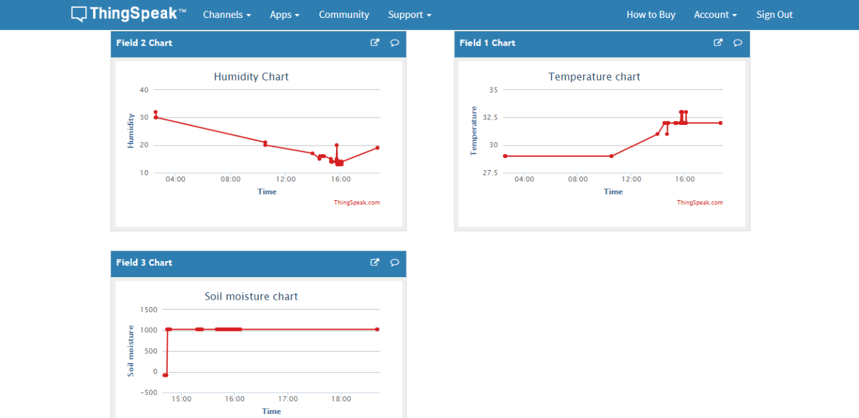
ThingSpeak Output

Slide 9
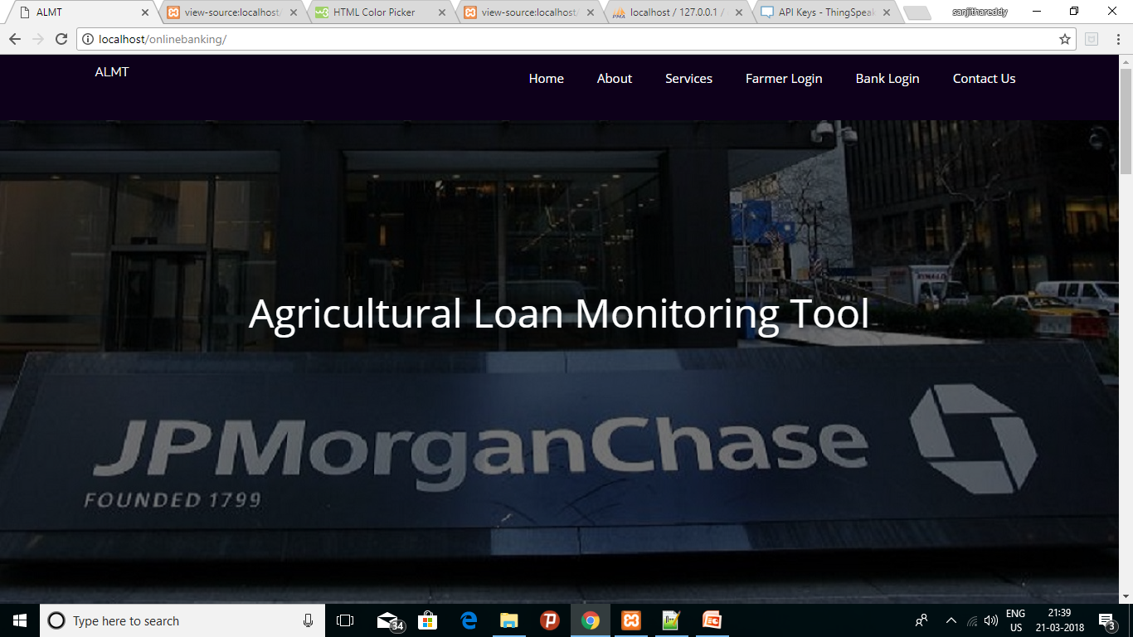
User Interface

Slide 10
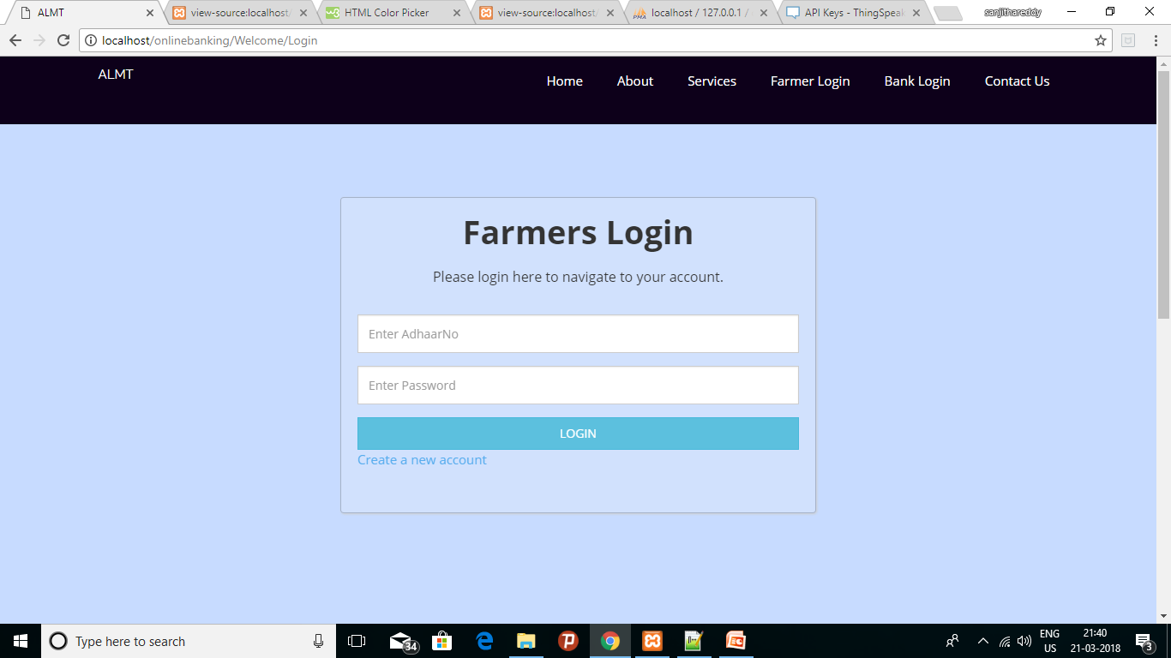
User Interface

Slide 11
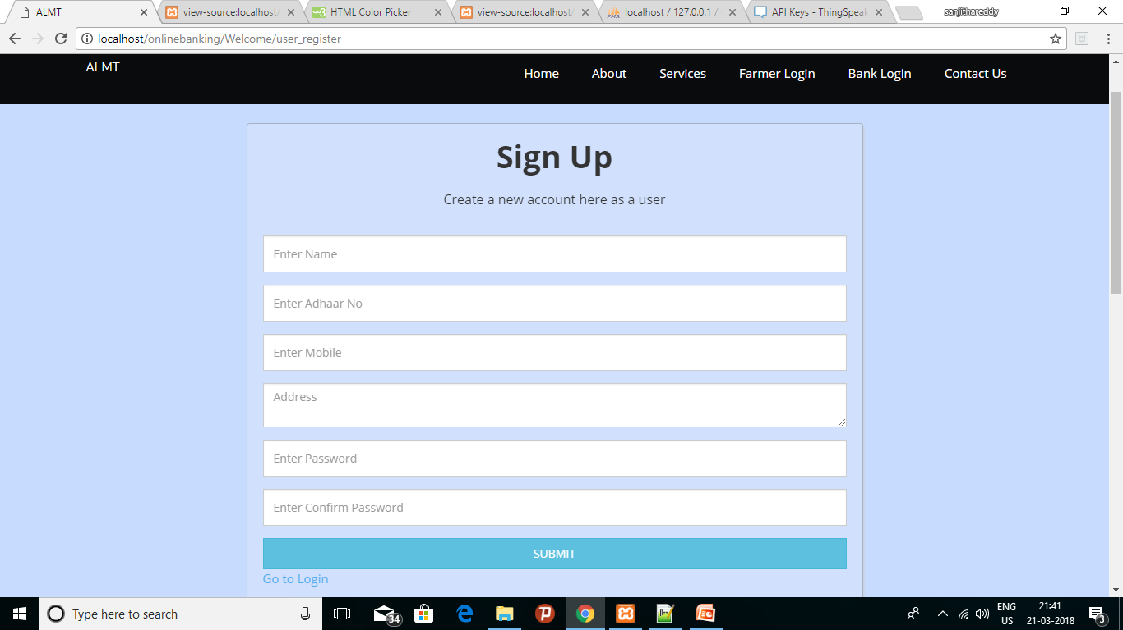
User Interface

Slide 12
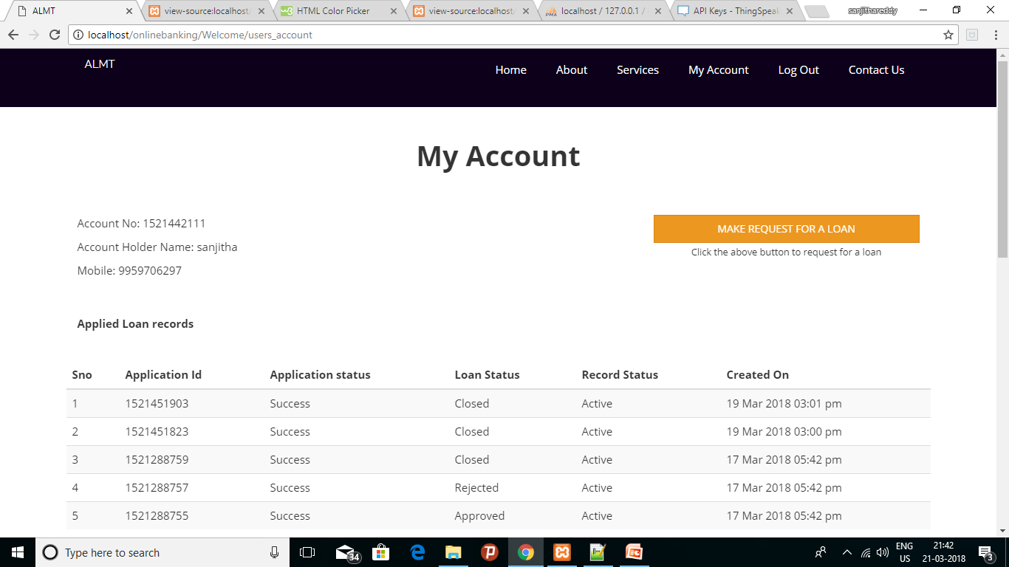
User Interface

Slide 13
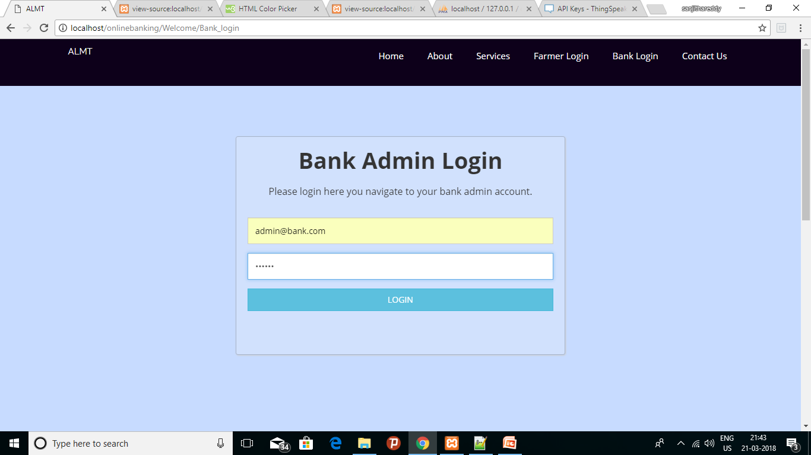
User Interface

Slide 14
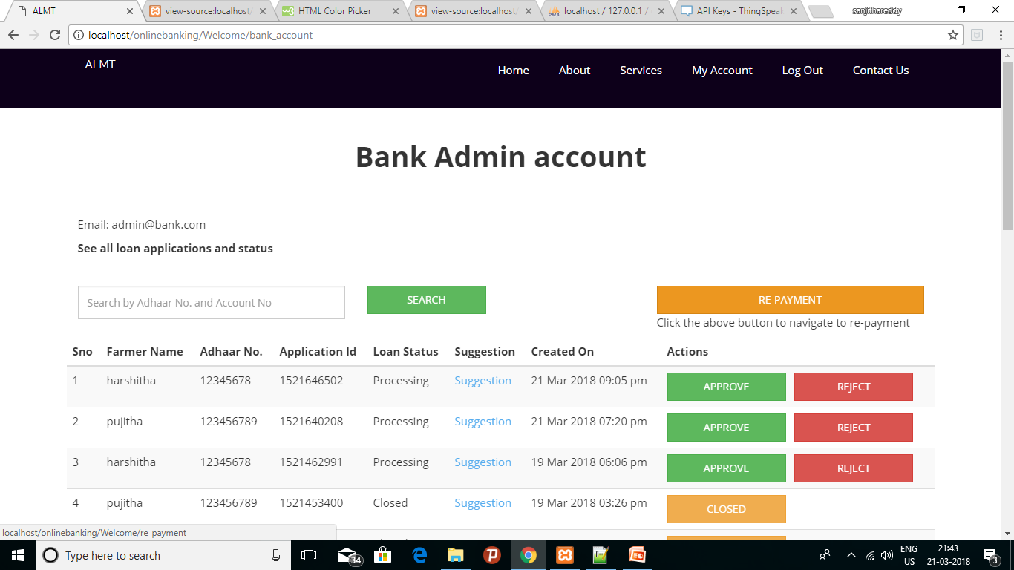
User Interface

Slide 15
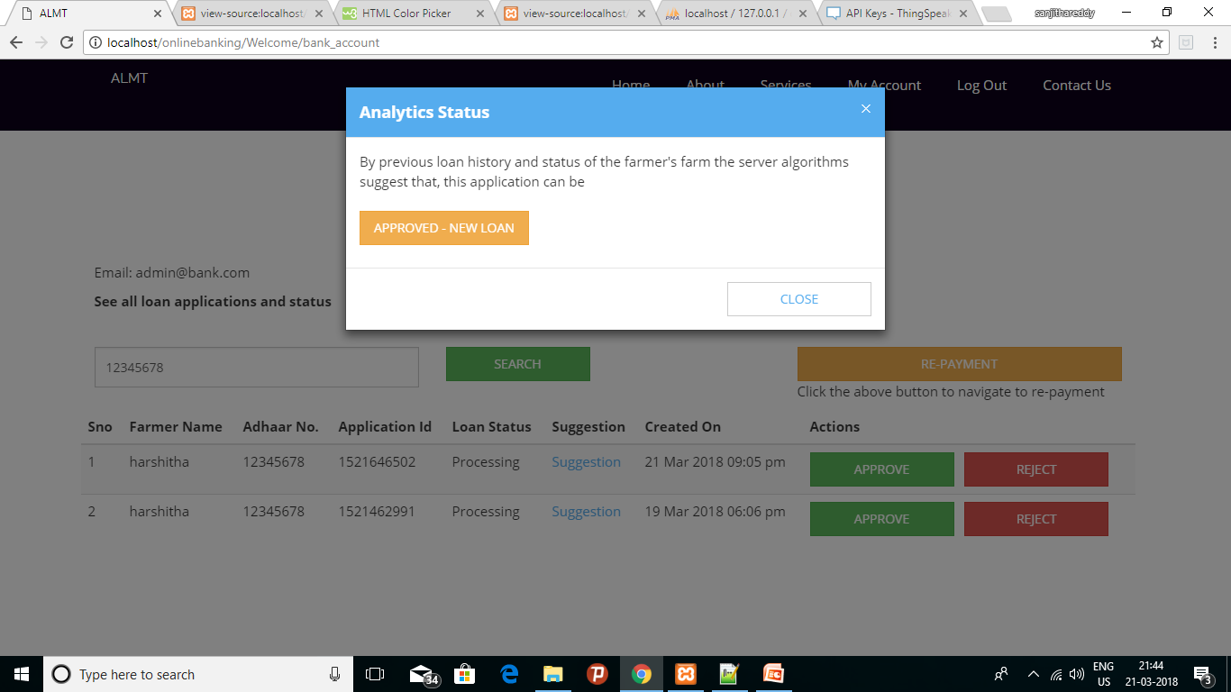
User Interface

Slide 16
Algorithm
Start
Loan History
Good
Bad
Crop Analysis
Crop
Analysis
Bad
Good
Bad
Good
No history
Approve
Approve in instalments
Approve
New Loan
Approve in instalments
Reject

Slide 17
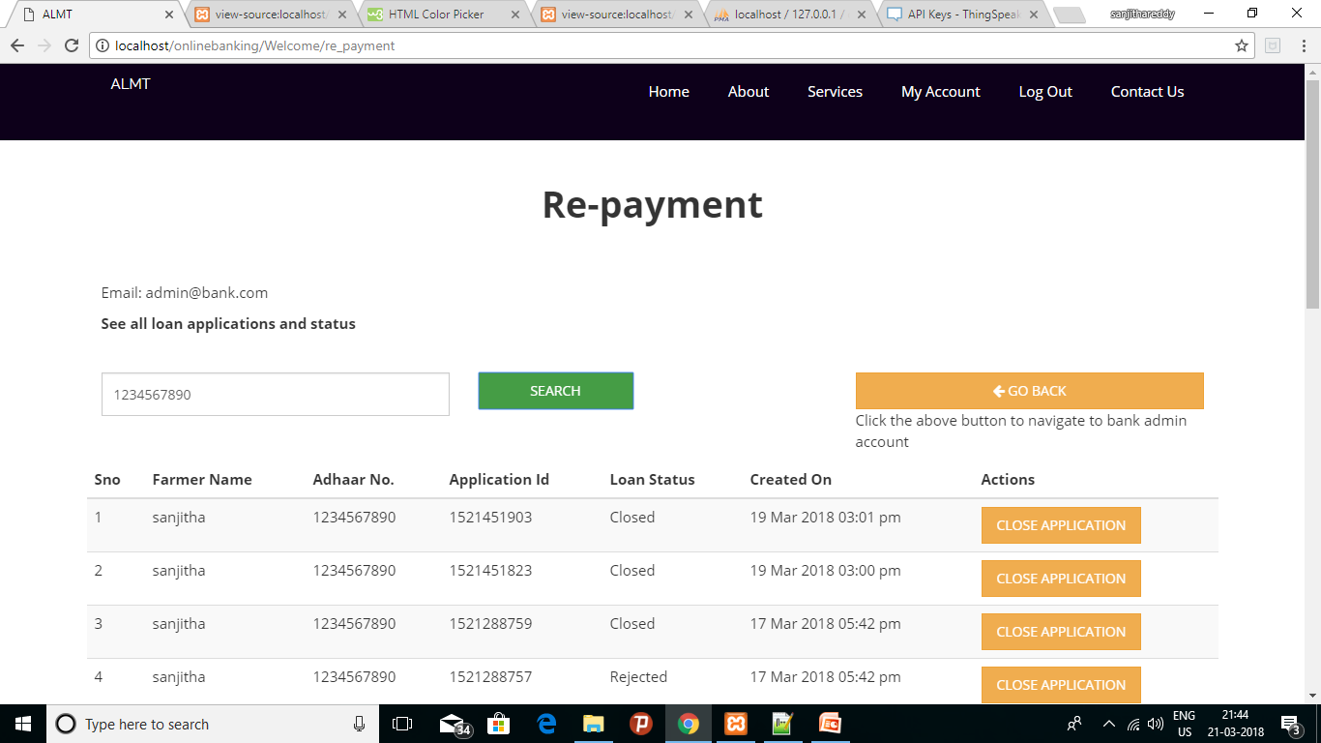
User Interface

Slide 18
Algorithm
Start
Loan History
Good
Bad
Crop Analysis
Crop
Analysis
Good
Bad
Good
Bad
Revenue can be generated
Revenue cannot be generated
Revenue can be generated
Revenue cannot be generated

Slide 19
CONCLUSION
Many loaning organizations and farmers can use this tool for better judgement and improve the crop outcome

Slide 20
THANK YOU

